Slide 1
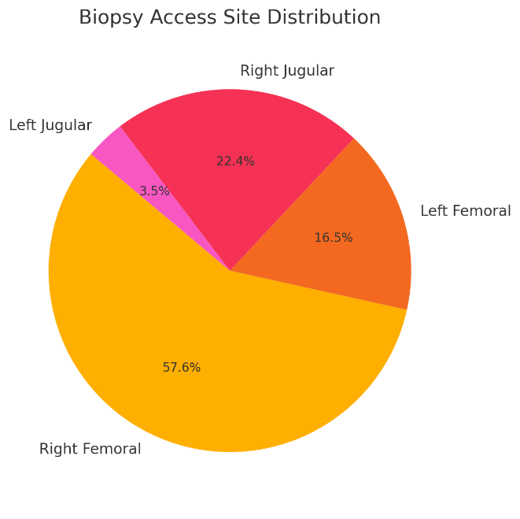
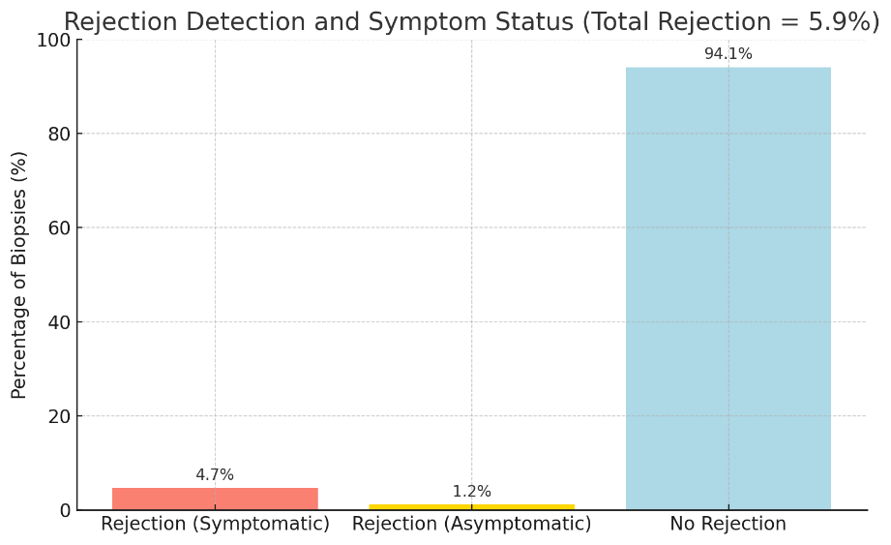
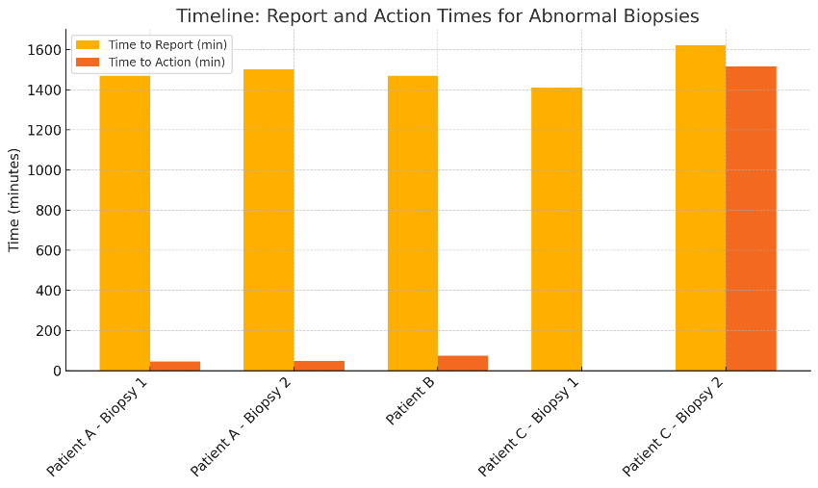

Quality Improvement Project on diagnosis of rejection in heart transplant recipients by optimising endomyocardial biopsy sampling and follow up.
V Sullivan
Introduction
Endomyocardial biopsy (EMB) is key for detecting rejection after heart transplant. Routine surveillance in asymptomatic patients has low diagnostic yield (1–2%), while symptomatic cases yield up to 18%1. Despite guidelines recommending ≥3 samples 2, some EMBs are inadequate due to fragmentation or poor quality. This quality improvement (QI) project assessed EMB adequacy, operator and access site variability, and timing of clinical response..
Methods
Results
Conclusion
Between August 2024 and February 2025, 85 biopsies were performed in 46 heart transplant patients. 15 (17.6%) were insufficient, mostly due to poor sample quality or low sample number. Insufficiency varied by access site, highest with Left Femoral (35.7%), and was primarily linked to one operator. Five biopsies (5.8%) confirmed rejection (3 ACR ≥2R, 2 AMR ≥2), including one asymptomatic case. EPIC reports were available within 23.5–27 hours, with most clinical actions taken within 1–2 hours. In one case, treatment began before reporting due to high clinical suspicion.
We increased the minimum biopsy sample count to four over a three-month period, with early signs of improved adequacy and ongoing data collection. An EPIC-based alert system is also being developed to flag abnormal results and streamline clinical response.
This QI project identified a notable rate of insufficient EMB samples, with variation by access site and operator. Increasing the minimum sample count and improving follow-up communication pathways may enhance diagnostic reliability and ensure timely treatment of rejection, ultimately improving outcomes for heart transplant recipients.
We analysed six months of biopsy data, evaluating sample adequacy (ISHLT criteria), rejection rates, report turnaround, and clinical response times. Two interventions were introduced: (1) increasing the minimum sample count to four to improve diagnostic accuracy, and (2) developing an EPIC-based alert system to flag abnormal results, ensuring timely clinical action and reducing the need for patient-initiated follow-up
We aim to enhance biopsy yield and diagnostic reliability while reducing follow-ups and ensuring timely clinical response.
References
The International Society for Heart and Lung Transplantation (ISHLT). ISHLT guidelines for the care of heart transplant recipients. J Heart Lung Transplant. 2023;42(5):e1–e141. https://doi.org/10.1016/j.healun.2022.10.015
Stewart S, Winters GL, Fishbein MC, Tazelaar HD, Kobashigawa J, Abrams J, et al. Revision of the 1990 working formulation for the standardization of nomenclature in the diagnosis of heart rejection. J Heart Lung Transplant. 2005;24(11):1710–20. https://doi.org/10.1016/j.healun.2005.03.019
Aims
Evaluate EMB adequacy rates.
Identify variation by access site/operator.
Assess timing of biopsy reporting and treatment.
Recommend improvements to increase diagnostic value.

