Slide 1


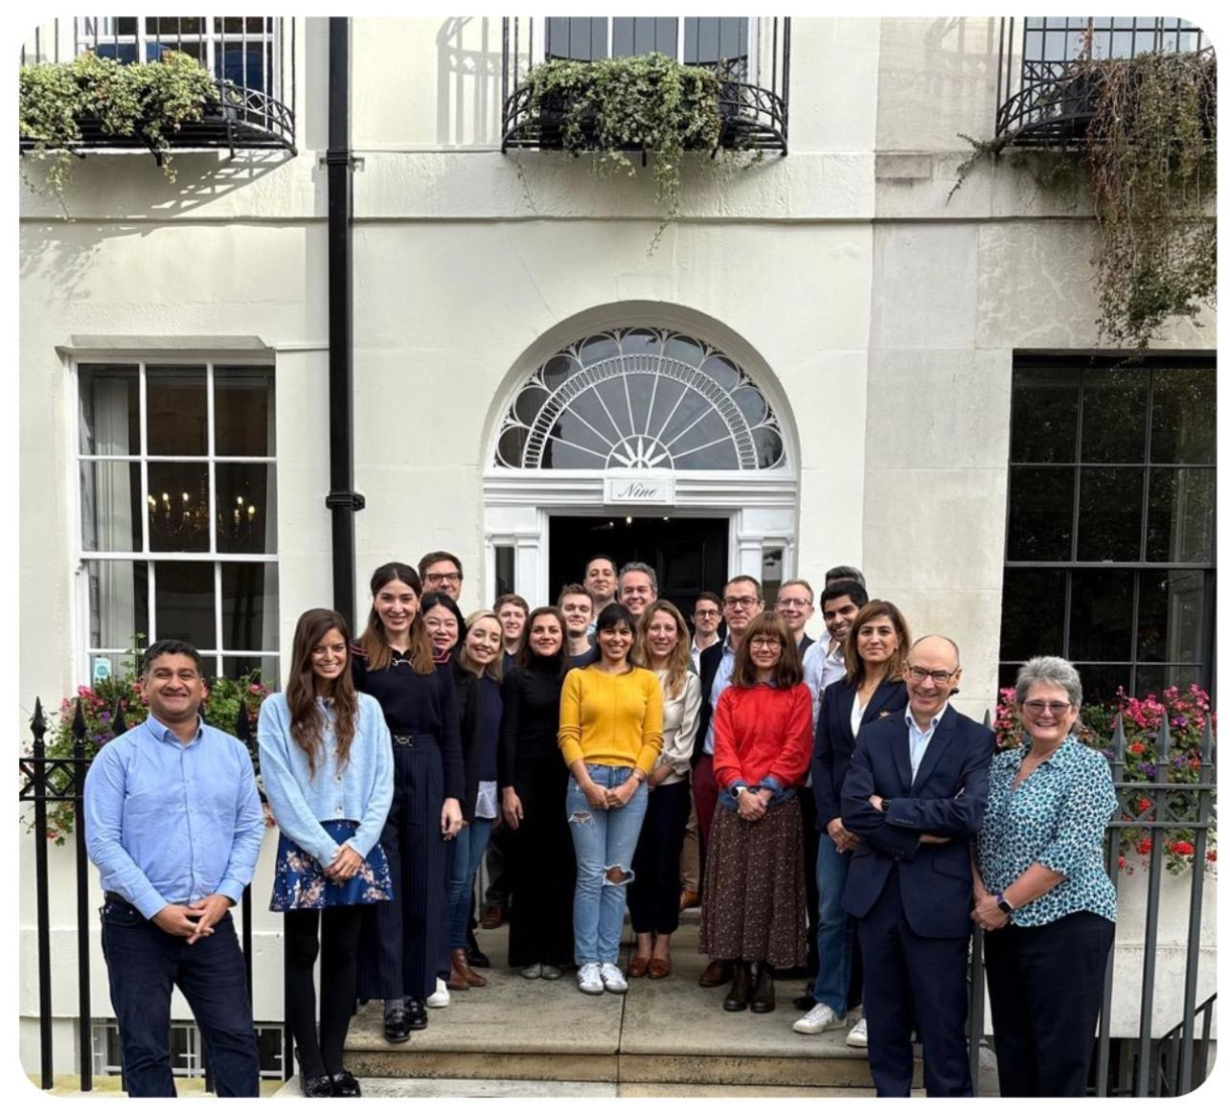
Establishing a Left Bundle Branch Area Pacing (LBBAP) Service in Cornwall
Dr Tiffany Kemp, Consultant Cardiologist (Heart Failure and Complex Devices)
British Cardiac Society Emerging Leaders Programme 2024-25 Delegate
Aim: To establish a safe, effective, and sustainable Left Bundle Branch Area Pacing (LBBAP) service in Cornwall for patients with bradycardia (and later for CRT indications).
Background
Left Bundle Area Pacing (LBBAP) is a pacing technique that offers significant advantages over standard Right Ventricular (RV) pacing. Long term RV pacing can lead to pacing induced cardiomyopathy, but LBBAP produces more synchronized ventricular contraction which helps maintain left ventricular function. Studies have shown show LBBAP improves exercise capacity, symptoms and quality of life. It also often results in lower and stable pacing thresholds which improves battery longevity and reduces the need for lead revision.
We had noted an increased number of requests for upgrade from standard RV pacemakers to cardiac resynchronization therapy due to a reduced in ejection fraction after RV pacemaker implantation. Other centres are now routinely offering LBBAP to reduce the need for this, but in Cornwall we have to refer our patients out of county and then cannot follow them up. This is particularly important as there is a higher than average elderly population in Cornwall and rural areas geography makes access to other centres more challenging.
It is therefore essential to offer evidence based cardiac pacing services locally to improve equity of access and enhance continuity of care.
Initial Results
The two complex pacing consultants in Cornwall have now attended two industry led LBBAP training courses and have visited other centres to observe LBBAP in practice. The two senior cardiac physiologists now trained in follow up of LBBAP.
A proctor has been identified and the arrangements made for suitable pacing lists for him to support the initial learning curve. Industry support has been obtained to provide the required equipment, and to support the Cornwall team as the service becomes established.
Conclusion
After the two complex pacing consultants are suitable trained the aim is to expand operator base to the two pacing consultants in addition. In the future the patients considered for LBBAP will expand to include those who have impaired LV function without left bundle branch block, and also to those who would usually have a CRT but cannot. It is predicted that LBBAP will replace conventional RV pacing as the first line treatment for bradycardia requiring a pacemaker.
Methods
Training and mentorship in LBBAP technique
Procurement of necessary sheaths and leads
Local protocol development and patient selection criteria
References
Chung et al (2023) ‘2023 HRS/APHRS/LAHRS guideline on cardiac physiologic pacing for the avoidance and mitigation of heart failure.’ Heart Rhythm, 20: e17-91
Vijayaraman et al (2023) ‘Comparison of left bundle area pacing and biventricular pacing in candidates for resynchronization therapy.’ Journal of American College of Cardiology, 92: 228-241
Ponnusamy et al (2022) ‘Left bundle branch pacing: a comprehensive review.’ Journal of Cardiovascular Electrophysiology, 31: 2462-2473
Challenges
There are currently only two heart failure and complex device consultants to cover all of Cornwall who also have general cardiology responsibilities. The learning curve means more time needs to be allocated to this new technique. This must be balanced against increasing demands on the pacing service with expanding waiting lists. Shortly after the start of the service development the pacing lab closed for refurbishment. The new pacing lab is now open again and being used.
There was a need for external proctorship and structured training. A high volume operator was approached who agreed and this was organized formally. Industry support was also arranged to assist with logistics of proctorship and the required equipment.

