Slide 1
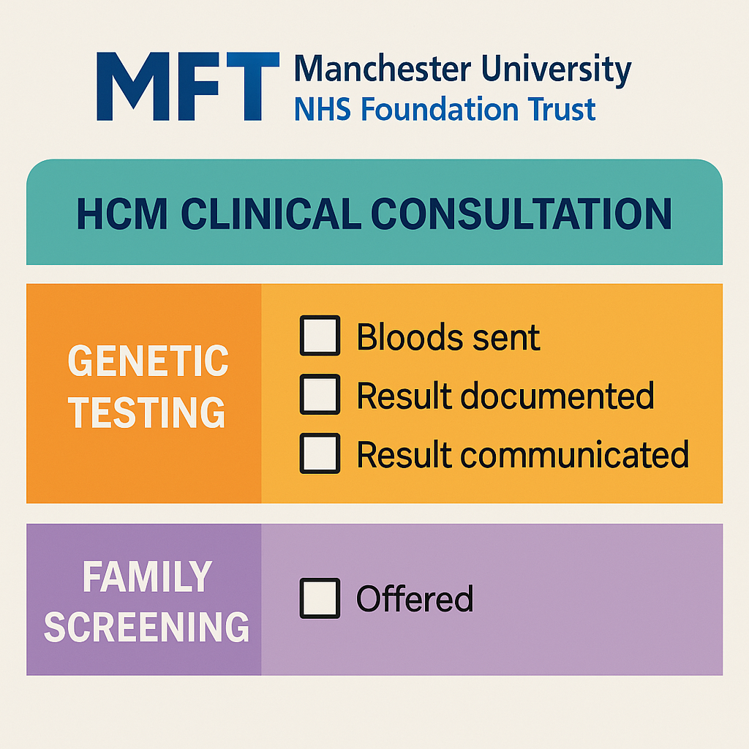

Are We Recording Adequate Data When We See HCM Patients?
Tamara Naneishvili , Khawaja Yawar Abbas , Rhys Beynon, Andrew Crean
Manchester University NHS Foundation Trust
Hypertrophic Cardiomyopathy (HCM) is a common inherited cardiac condition linked to sudden cardiac death, arrhythmias and heart failure.
The 2023 ESC guidelines and the British Heart Foundation recommend offering genetic testing promptly after diagnosis to support personalised management and cascade screening.
Genetic testing enables accurate diagnosis, risk stratification, and identification of at-risk family members.
Despite clear guidance, adherence to these recommendations remains inconsistent in clinical practice.
Methods
Interim results
Conclusion
Retrospective audit of 1000 consecutive patients with confirmed or suspected HCM seen between January 2006 and December 2024.
Patient data were extracted from the EPIC electronic health records system at Manchester University NHS Foundation Trust (MFT).
The primary outcomes assessed were:
Demographics
Documentation of genetic testing offered within six months of the initial clinic appointment.
Evidence of result communication via letter, telephone, or face-to-face consultation.
Explicit documentation that family screening was offered.
Data from the first 400 patients reviewed show substantial shortfalls against the audit standard.
Only 30–40% had documented:
Offer of genetic testing within six months.
Communication of results (via letter, telephone, or face-to-face).
Offer of family screening.
These findings highlights significant under-performance relative to guideline expectations.
Results have been presented at the Inherited Cardiac Conditions (ICC) MDT for discussion and planning of next steps.
Interim findings confirm that clinicians are under-documenting and potentially under-offering genetic testing for HCM.
This gap in adherence may negatively impact patient safety, risk assessment, and the effectiveness of family screening.
To improve compliance, we plan to implement a structured consultation template to prompt:
Offer of genetic testing
Communication of results
Offer of cascade screening
Reminder posters will be displayed in clinic rooms and shared with ICC clinicians.
A re-audit is planned to evaluate improvements in documentation and adherence to national guidelines.
Objectives
Assess the proportion of patients with HCM who were offered genetic testing within six months of their initial clinic appointment at Manchester University NHS Foundation Trust (MFT).
An audit standard was established at 90% compliance for documentation and communication of genetic testing results, including offering family screening.
References
Arbelo E, Protonotarios A, Gimeno JR, et al. 2023 ESC Guidelines for the management of cardiomyopathies: Developed by the task force on the management of cardiomyopathies of the European Society of Cardiology (ESC). European Heart Journal. 2023;44(37):3503–3626. doi:10.1093/eurheartj/ehad194

