Slide 1
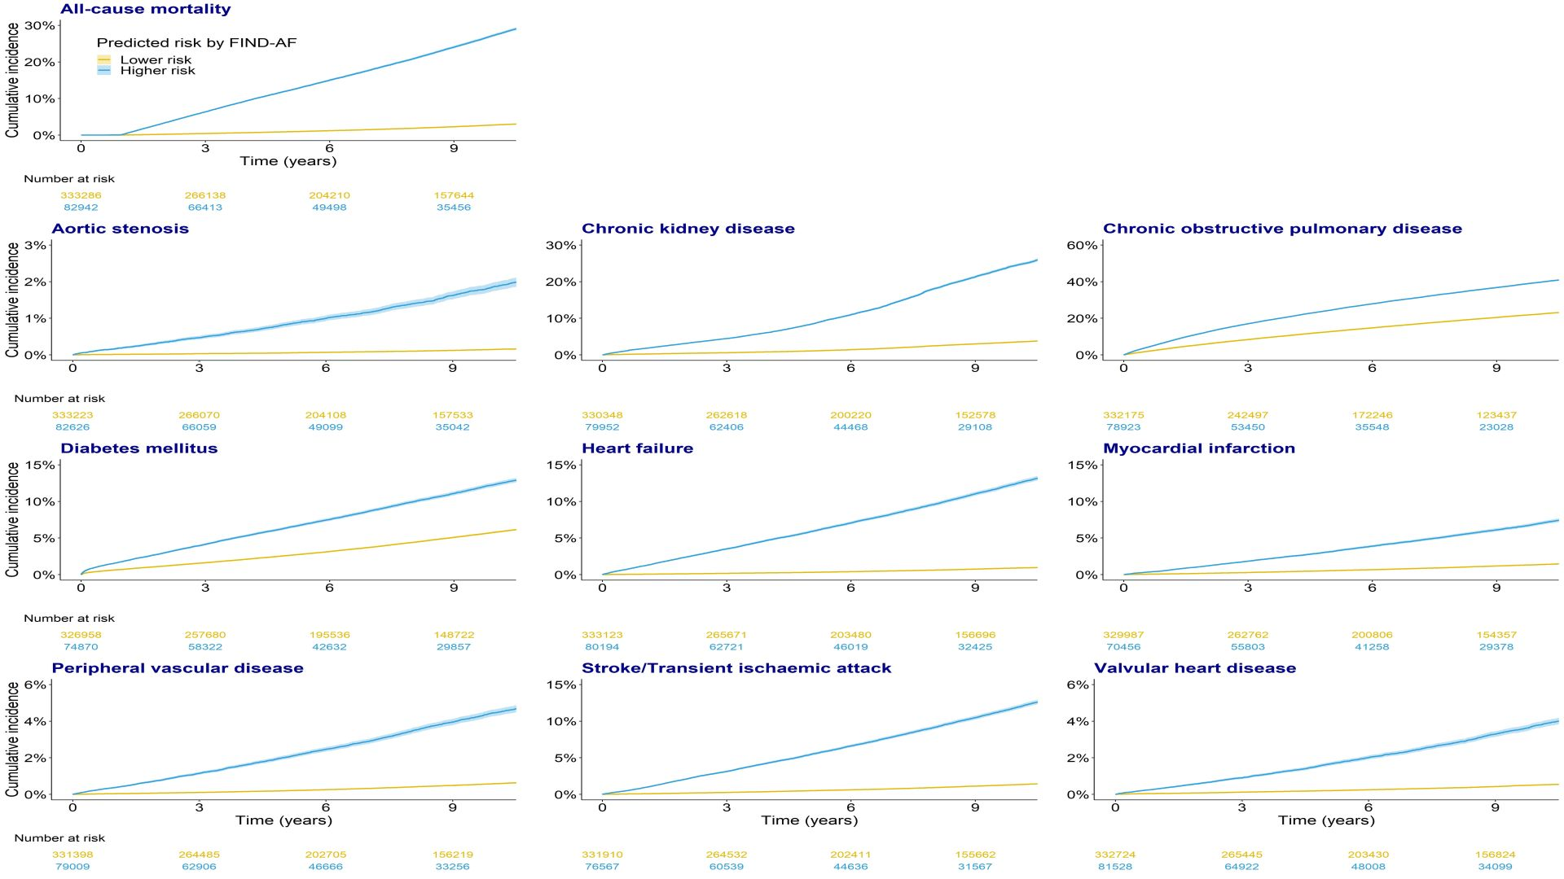
Cardiologist-led community optimisation of cardio-renal-metabolic risk factors: OPTIMISE
Nadarajah R, Wahab A, Reynolds C Haris M, Joseph T, Hurdus B, Wu J, Gale CP
Leeds Teaching Hospitals NHTS Trust; Leeds Institute of Cardiovascular and Metabolic Medicine
BACKGROUND
RESULTS
1
3
Cardiovascular disease (CVD) causes a quarter of all deaths in the UK, and the NHS Long Term Plan emphasises that earlier detection and treatment of cardiovascular, renal and metabolic risk factors is a priority.
We have developed a machine learning algorithm (OPTIMISE) that identifies people at higher risk of cardio-renal-metabolic disease and death
In the pilot clinical implementation (n=82):
78% had hypertension
23.1% of those with type 2 diabetes and co-existent CKD were on SGLT2 inhibitor
37% of those with previous CVD had LDL >2.0 mmol/L
19.5% had undiagnosed moderate or high risk CKD
49% were obese
17% were eligible for GLP-1 RA therapy
METHODS
2
We calculated the cumulative incidence rate for ten cardio-renal-metabolic diseases and death for patients aged ≥30 years in primary care by OPTIMISE risk strata.
Across 3 PCNs we have identified patients at elevated OPTIMISE risk and assessed guideline-adherence for cardio-renal-metabolic diseases
Figure 1. Predicted risk and long-term risk of conditions in the testing dataset (n=416 228)
CONCLUSION
4
The machine learning OPTIMISE algorithm can identify people at higher risk of cardio-renal-metabolic diseases and death in UK primary care EHR data.
On prospective evaluation higher risk individuals have unrecorded and undertreated cardio-renal-metabolic diseases, which are actionable targets for integrated multi-disciplinary preventative care.

Slide 2
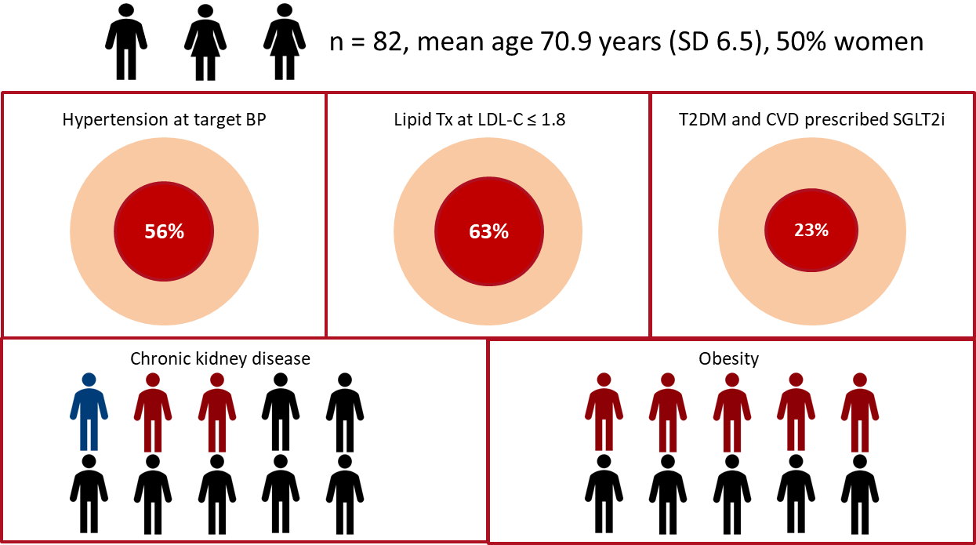
Cardiologist-led community optimisation of cardio-renal-metabolic risk factors: OPTIMISE
Nadarajah R, Wahab A, Reynolds C Haris M, Joseph T, Hurdus B, Wu J, Gale CP
Leeds Teaching Hospitals NHTS Trust; Leeds Institute of Cardiovascular and Metabolic Medicine
METHODS
BACKGROUND
2
1
Cardiovascular disease causes a quarter of all deaths in the UK, and the NHS Long Term Plan emphasises earlier detection and treatment of cardio-renal-metabolic risk factors. We can identify people at higher risk of cardio-renal-metabolic (CRM) disease and death with machine learning in primary care records (OPTIMISE).
We calculated the cumulative incidence rate for ten cardio-renal-metabolic diseases and death for patients aged ≥30 years in primary care by OPTIMISE risk strata.
Across 3 PCNs we identified patients at elevated OPTIMISE risk and assessed guideline-adherence for CRM diseases.
RESULTS
3
Figure 1. Long-term incidence of adverse events by risk strata
Figure 2. Adherence to guidelines and diagnostic coding for CRM conditions
CONCLUSION
4
It is feasible to identify people at higher risk of CRM adverse events using machine learning in primary care records.
When reviewed by a specialist in the community higher risk patients have undetected and sub-optimally managed CRM risk factors
The clinical and cost-effectiveness of specialist-led care in the community to optimise CRM risk factors is undergoing assessment through piloting and prospective randomised assessment

