Slide 1
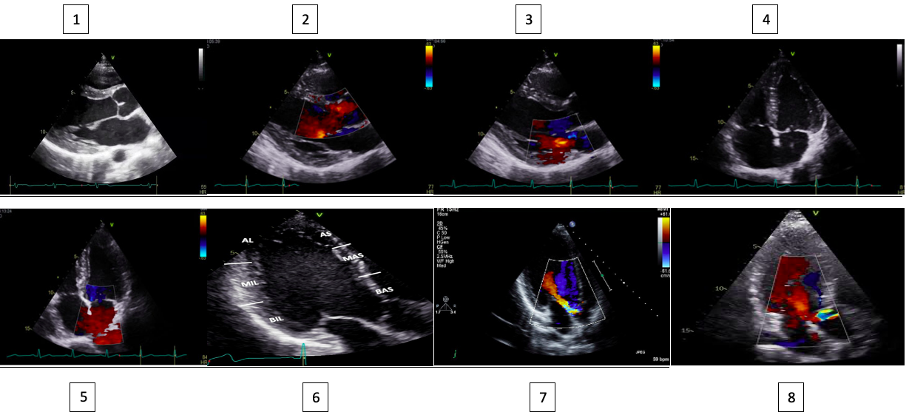

Focused Echocardiography in Primary Care: A Training Protocol to detect Structural Heart Disease and Reduce Referrals
Dr Nabila Laskar
St Bartholomews Hospital, Barts Health NHS Trust
INTRODUCTION
Traditional echocardiography is time-consuming (40+ mins/scan) and requires expertise.
3-month waiting lists in primary care for routine scans, yet >30% show no pathology.
No existing guidelines for focused echo in primary care, unlike hospital settings (e.g., FUSIC).
Study Design: Prospective cohort
Participants: 4 novice operators (GPs/nurses/medical student)
Community patients ≥65 years (n=50/operator)
Protocol: 7-key view focused echo scan (<15 mins) Abbreviated report → Full echo if abnormal
Quality Control: All scans reviewed by consultant cardiologist Discordant cases flagged for re-evaluation
✅ Detection Rate:
SHD identified in 34% of scans 2.3% referred to secondary care
✅ Operator Performance: 89% diagnostic accuracy (vs. gold standard) 0% critical misses (e.g., severe LV dysfunction)
✅ Efficiency: Scan time reduced by 60% (40 mins → 10 mins) 100% feasibility in GP clinic settings
Focussed echocardiography is viable in primary care with structured training.
Reduces unnecessary referrals by enabling on-site screening.
Next Steps:
Scale training to 20+ practices
Long-term follow-up for cost-effectiveness
Develop a 7-image focused echo protocol to detect: Left ventricular dysfunction Significant left-sided valve disease
Train novice users (0 prior echo experience) via: 2.5-hour theoretical module Supervised scans (50 cases)
Evaluate real-world performance: Diagnostic accuracy vs. expert review New primary care focused echo protocol
Via G, Hussain A, Wells M, et al. International evidence-based recommendations for focused cardiac ultrasound. J Am Soc Echocardiogr. 2014;27(7):683.e1-683.e33. doi:10.1016/j.echo.2014.05.001
Andersen GN, Graven T, Skjetne K, et al. Diagnostic influence of routine point-of-care pocket-size ultrasound examinations performed by medical residents. J Ultrasound Med. 2015;34(4):627-636. doi:10.7863/ultra.34.4.627

