Slide 1
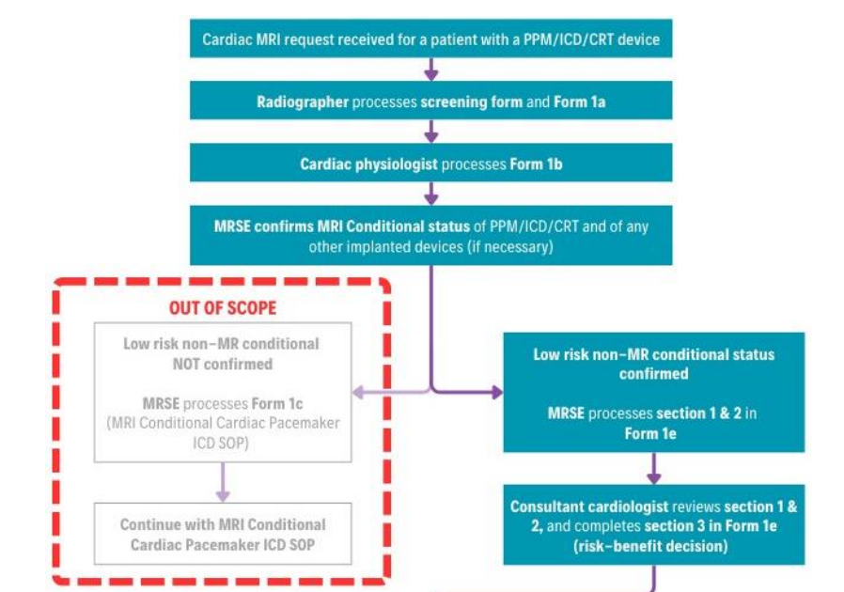
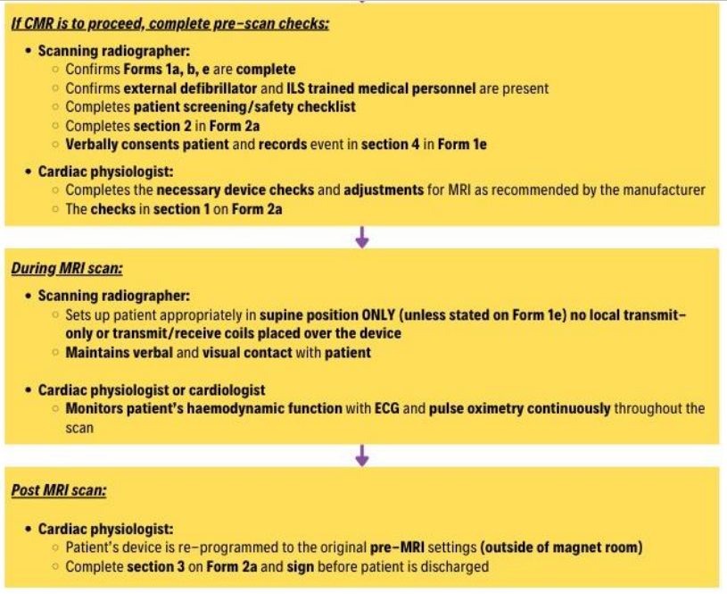
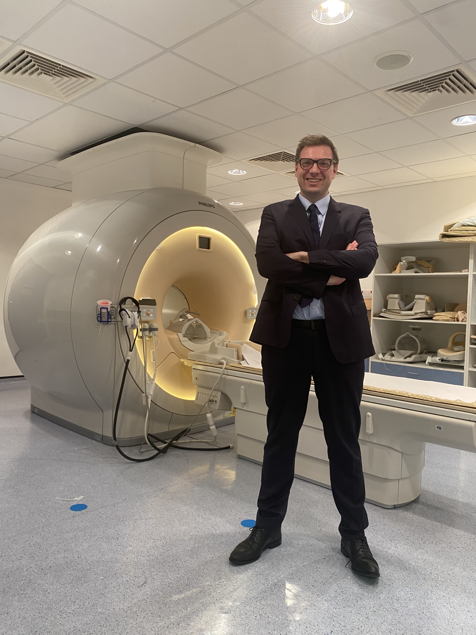

Establishing a Pathway for Cardiac MRI in Patients with Non-MR Conditional Cardiac Implantable Electronic Devices (CIEDs)
Methods
Results
Conclusions
Dr Kristopher Knott MBBS MA (Cantab) PhD MRCP
A multidisciplinary team developed a stepwise SOP and checklist process including:
Device and imaging review (Forms 1a & 1b)
Formal risk–benefit assessment by MRI physicist and consultant cardiologist (Form 1e)
Pre-scan programming and monitoring plan (Form 2a)
MRI performed at 1.5T in normal operating mode, SAR ≤ 2.0 W/kg
Continuous ECG + pulse oximetry, resuscitation support, and verbal contact maintained
Strict inclusion criteria: e.g. MR conditional generator with unlabelled leads, no abandoned hardware
SOP formally approved by MR Safety Committee
First patient scanned safely under the pathway (device/lead mismatch)
No adverse events
Workflow successfully executed with radiology, cardiology, and cardiac physiology teams
We successfully implemented a safe, governed pathway for scanning non-MR conditional device patients. The protocol is reproducible and expandable. Early experience supports broader rollout under ongoing audit.
St George’s Hospitals NHS Foundation Trust
Cardiac MRI (CMR) offers unique diagnostic insights in cardiomyopathy, viability, and structural heart disease. However, patients with non-MR conditional cardiac devices (CIEDs) are typically excluded from CMR due to safety concerns. Despite growing evidence for feasibility with precautions, no local pathway existed at our institution for these cases.This project aimed to create a standardised and safe protocol to scan selected non-MR conditional patients with CIEDs.
References
St George's University Hospitals NHS Foundation Trust. Standard Operating Procedures for Magnetic Resonance Imaging of Non-MR Conditional Cardiac Pacemakers, Internal Cardiac Defibrillators, and Cardiac Resynchronisation Therapy Devices. Version 1.0. February 2025. [Internal Trust Document]
Discussion
This pathway allows carefully selected patients with non-MR conditional devices to access essential diagnostic imaging. Implementation required new interdepartmental workflows, and a clear understanding of device behaviour in MRI environments. Key limitations:
Resource-intensive (senior staff required for programming and monitoring)
Limited to weekday availability
Restricted to low-risk configurations only
Acknowledgements
Objectives
The St George's University Hospitals NHS Foundation Trust MR Conditional Pacemaker Working Group (MRCPWG).
Departments of Cardiology, Radiology, and Medical Physics, St George's University Hospitals NHS FT.
The British Cardiovascular Society (BCS) Emerging Leaders Programme.
Design and implement a safe, local SOP for scanning selected patients with non-MR conditional CIEDs.
Enable diagnostic access to cardiac MRI for a subgroup of patients currently excluded.
Ensure full regulatory, safety, and multidisciplinary alignment to national and international guidance.
Evaluate feasibility through early case implementation and outcomes tracking.

