Slide 1
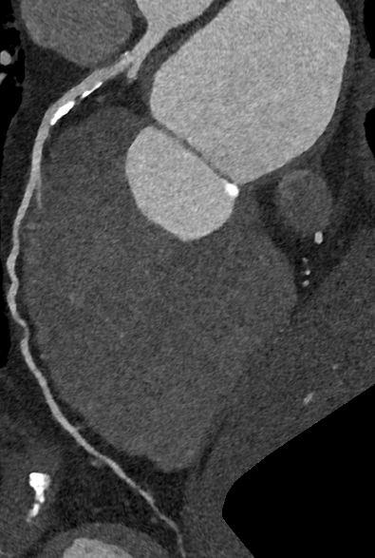
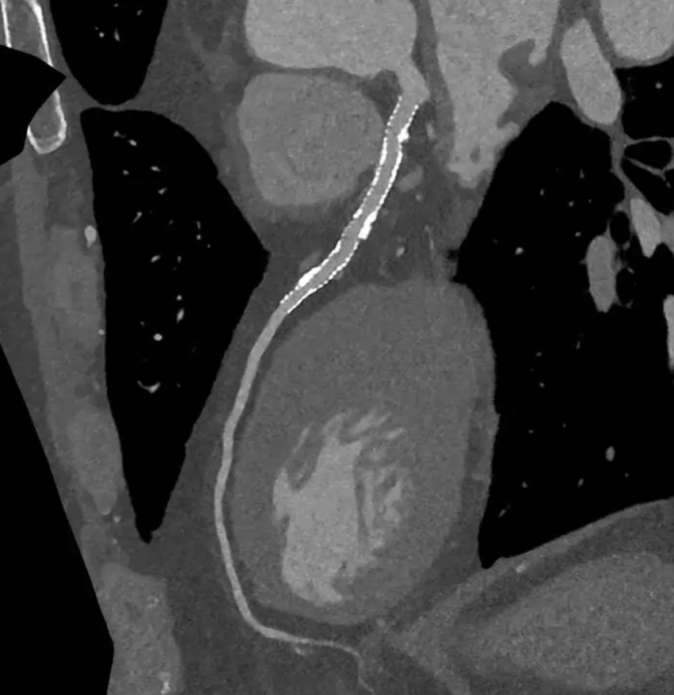

Defining the optimal CT coronary artery calcium score threshold for utilising ultra-high resolution imaging in photon-counting CT
Dr Joseph McCambridge,¹ Dr Jonathan Weir-McCall¹, Prof Ed Nicol¹, Dr Thomas Semple¹
¹Royal Brompton Hospital, Guy’s and St Thomas’ NHS Foundation Trust
Introduction
Methods
Results
Conclusions
This study aims to define the optimal CAC score threshold for employing UHR mode in PCCT in those without prior stenting. The current sample size is too small to draw definitive conclusions, however, there is a trend towards patients with higher calcium scores being more likely to have potentially significant coronary stenoses. Further analysis is needed in this ongoing study.
All CT coronary angiograms (CTCA) performed in UHR mode on the Siemens NAEOTOM Alpha PCCT scanner in the Royal Brompton Hospital since installation will be included in this study. This interim analysis includes all relevant cases performed from 1st March to 28th April 2025. Cases with coronary stents are excluded. Each is classified into one of two groups based on the consultant reported severity of the worst coronary artery stenosis: 1. those with a mild stenosis or less (i.e. <50% luminal stenosis); 2. those with a potentially significant stenosis graded as moderate or higher (i.e. ≥50% luminal stenosis). Ultimately, the severity of stenosis will be correlated with CAC score to identify the optimal threshold for employing UHR. Due to the small sample size at the time of analysis, results are presented using descriptive statistics.
Between 1st March and 28th April 2025, a total of 77 CTCAs were performed, 11 of which were acquired in UHR mode. Of the 11 in UHR, 5 had coronary stents. Of the remaining 6 patients with calcium scores of 100 AU or more, 4 had a moderate or greater stenosis and 2 had a mild stenosis at worst. Those with a moderate or greater stenosis had numerically higher CAC scores (figure 1). The average radiation dose, represented as dose-length product (DLP), in UHR mode is 508.6 mGy.cm (standard deviation, SD 142 mGy.cm). The DLP for Quantum and Quantum Plus modes were 161.8 mGy.cm (SD 104.5 mGy.cm) and 303.2 mGy.cm (SD 299 mGy.cm) respectively.
Photon-counting computed tomography (PCCT) provides better spatial resolution, contrast sensitivity, and reduced noise compared to conventional dual-source energy CT scanners, and allows greater precision in the assessment of coronary artery calcification (CAC) and coronary stent patency. Images can be acquired at a very high spatial resolution with a slice thickness of 0.2mm, commonly known as Ultra-High Resolution (UHR). However, UHR mode increases radiation dose and reconstruction/processing time and is reserved for cases where the benefits in diagnostic accuracy outweigh any potential drawbacks. Without prior coronary stenting, the decision to utilise UHR mode is generally guided by a patient’s CT CAC score. At present in our institution, UHR mode is utilised when an automated CAC score reaches 100 Agatston units (AU) or higher. However, there remains debate as to whether this is the optimal cutoff for employing UHR mode or whether a higher cutoff would maintain the same level of diagnostic benefit while avoiding unnecessary radiation exposure among cases where more standard resolution modes (known as Quantum and Quantum Plus) are likely to be adequate. This project was designed to inform the optimal CAC score threshold for UHR imaging.
2B
2A
Figure2A. Patent proximal LAD stent in UHR
Figure 2B. Mixed plaque in proximal LAD in UHR
Figure 1.

