Slide 1
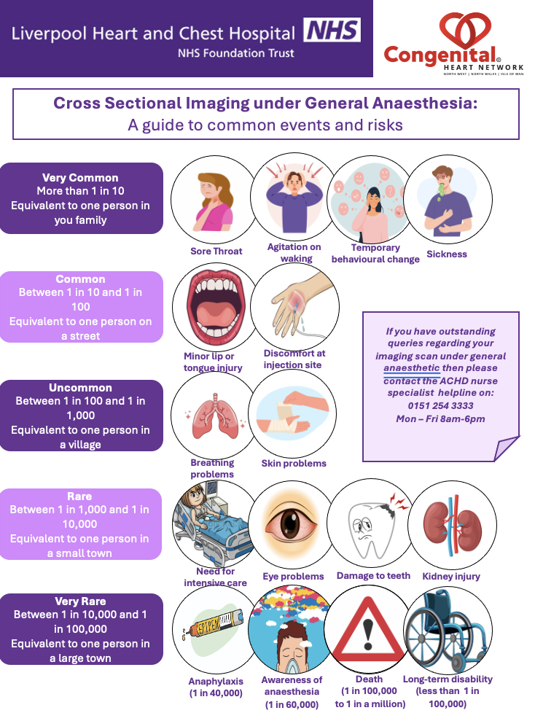
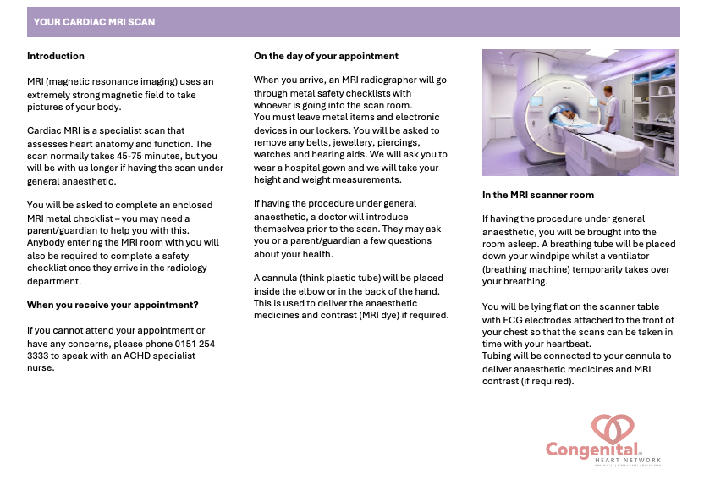
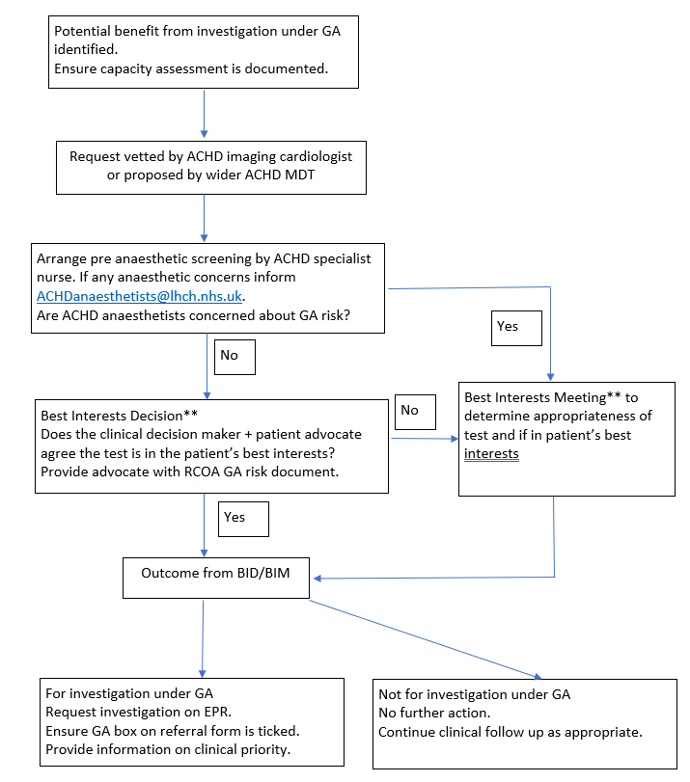
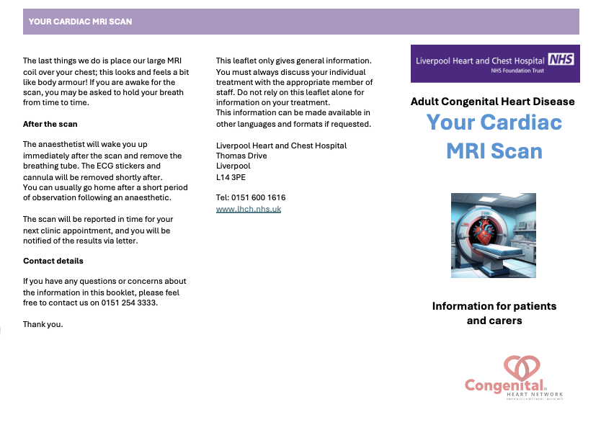

Cross-sectional Imaging of ACHD Patients Under General Anaesthesia – A service review
Dr Jonathan Senior
Liverpool Heart and Chest Hospital, Liverpool, UK No conflict of interests
Intellectual disabilities are common in patients with Adult Congenital Heart Disease. ^{[1]}
Cross-sectional imaging is routinely used for surveillance of ACHD patients and is recommended in international guidelines. ^{[2]}
Cardiac MRI may be poorly tolerated due to claustrophobia, scan duration and difficulty following breath hold instructions.
Facilitating cMRI under general anaesthesia poses significant logistical challenges that may lead to lengthy delays and adverse health outcomes.
METHODS
RESOURCES
With the assistance of the trust audit department, we completed a process map involving the key stakeholders in the delivery of the current GA imaging service. Through this process we identified current concerns, interdepartmental constraints and areas of potential conflict.
Resolutions were proposed to ease the current burden on the anaesthetic and radiology departments, whilst optimising the patient and carer experience.
In addition to the anaesthetic assessment tool led by an ACHD specialist nurse, the following documents were developed for patients and carers:
OUTCOMES
The following protocol was proposed:
OBJECTIVES
RESULTS & CONCLUSIONS
Develop a pathway to streamline both the referral and assessment process for cross-sectional imaging under GA.
Ease the workload of ACHD, anaesthetic and radiology colleagues during the pre-procedural work-up.
Optimise the experience to minimise distress for both patients and their carers.
The revised Standard Operating Procedure (SOP) and associated documentation will be implemented upon completion of review and formal approval by the ACHD, anaesthetic, and radiology working groups. Subsequent outcomes will be subject to systematic audit.
REFERENCES
1, Carvalho CM, Lupski JR. Mechanisms underlying structural variant formation in genomic disorders. Nat Rev Genet. 2016; 17: 224-238.
2. Baumgartner H, De Backer J, Babu-Narayan S et al. 2020 ESC Guidelines for the management of adult congenital heart disease; The Task Force for the management of adult congenital heart disease of the European Society of Cardiology (ESC). EHJ. 2021; 42 (6); 563-645.

