Slide 1

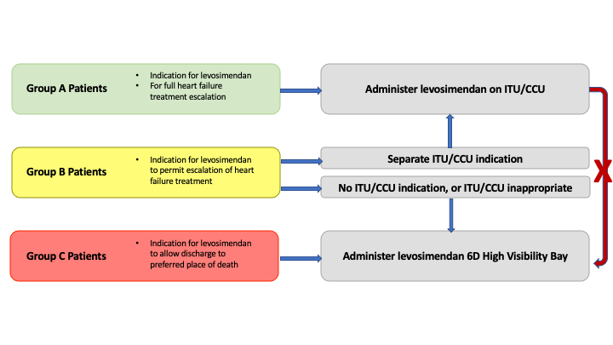
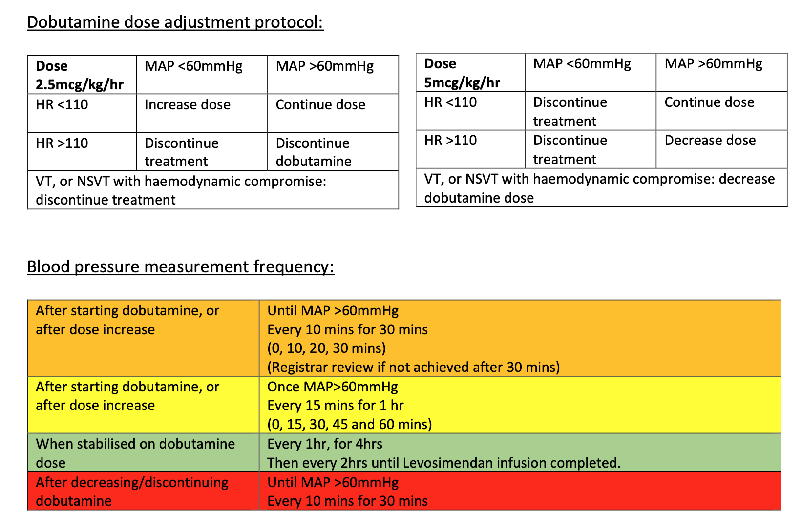

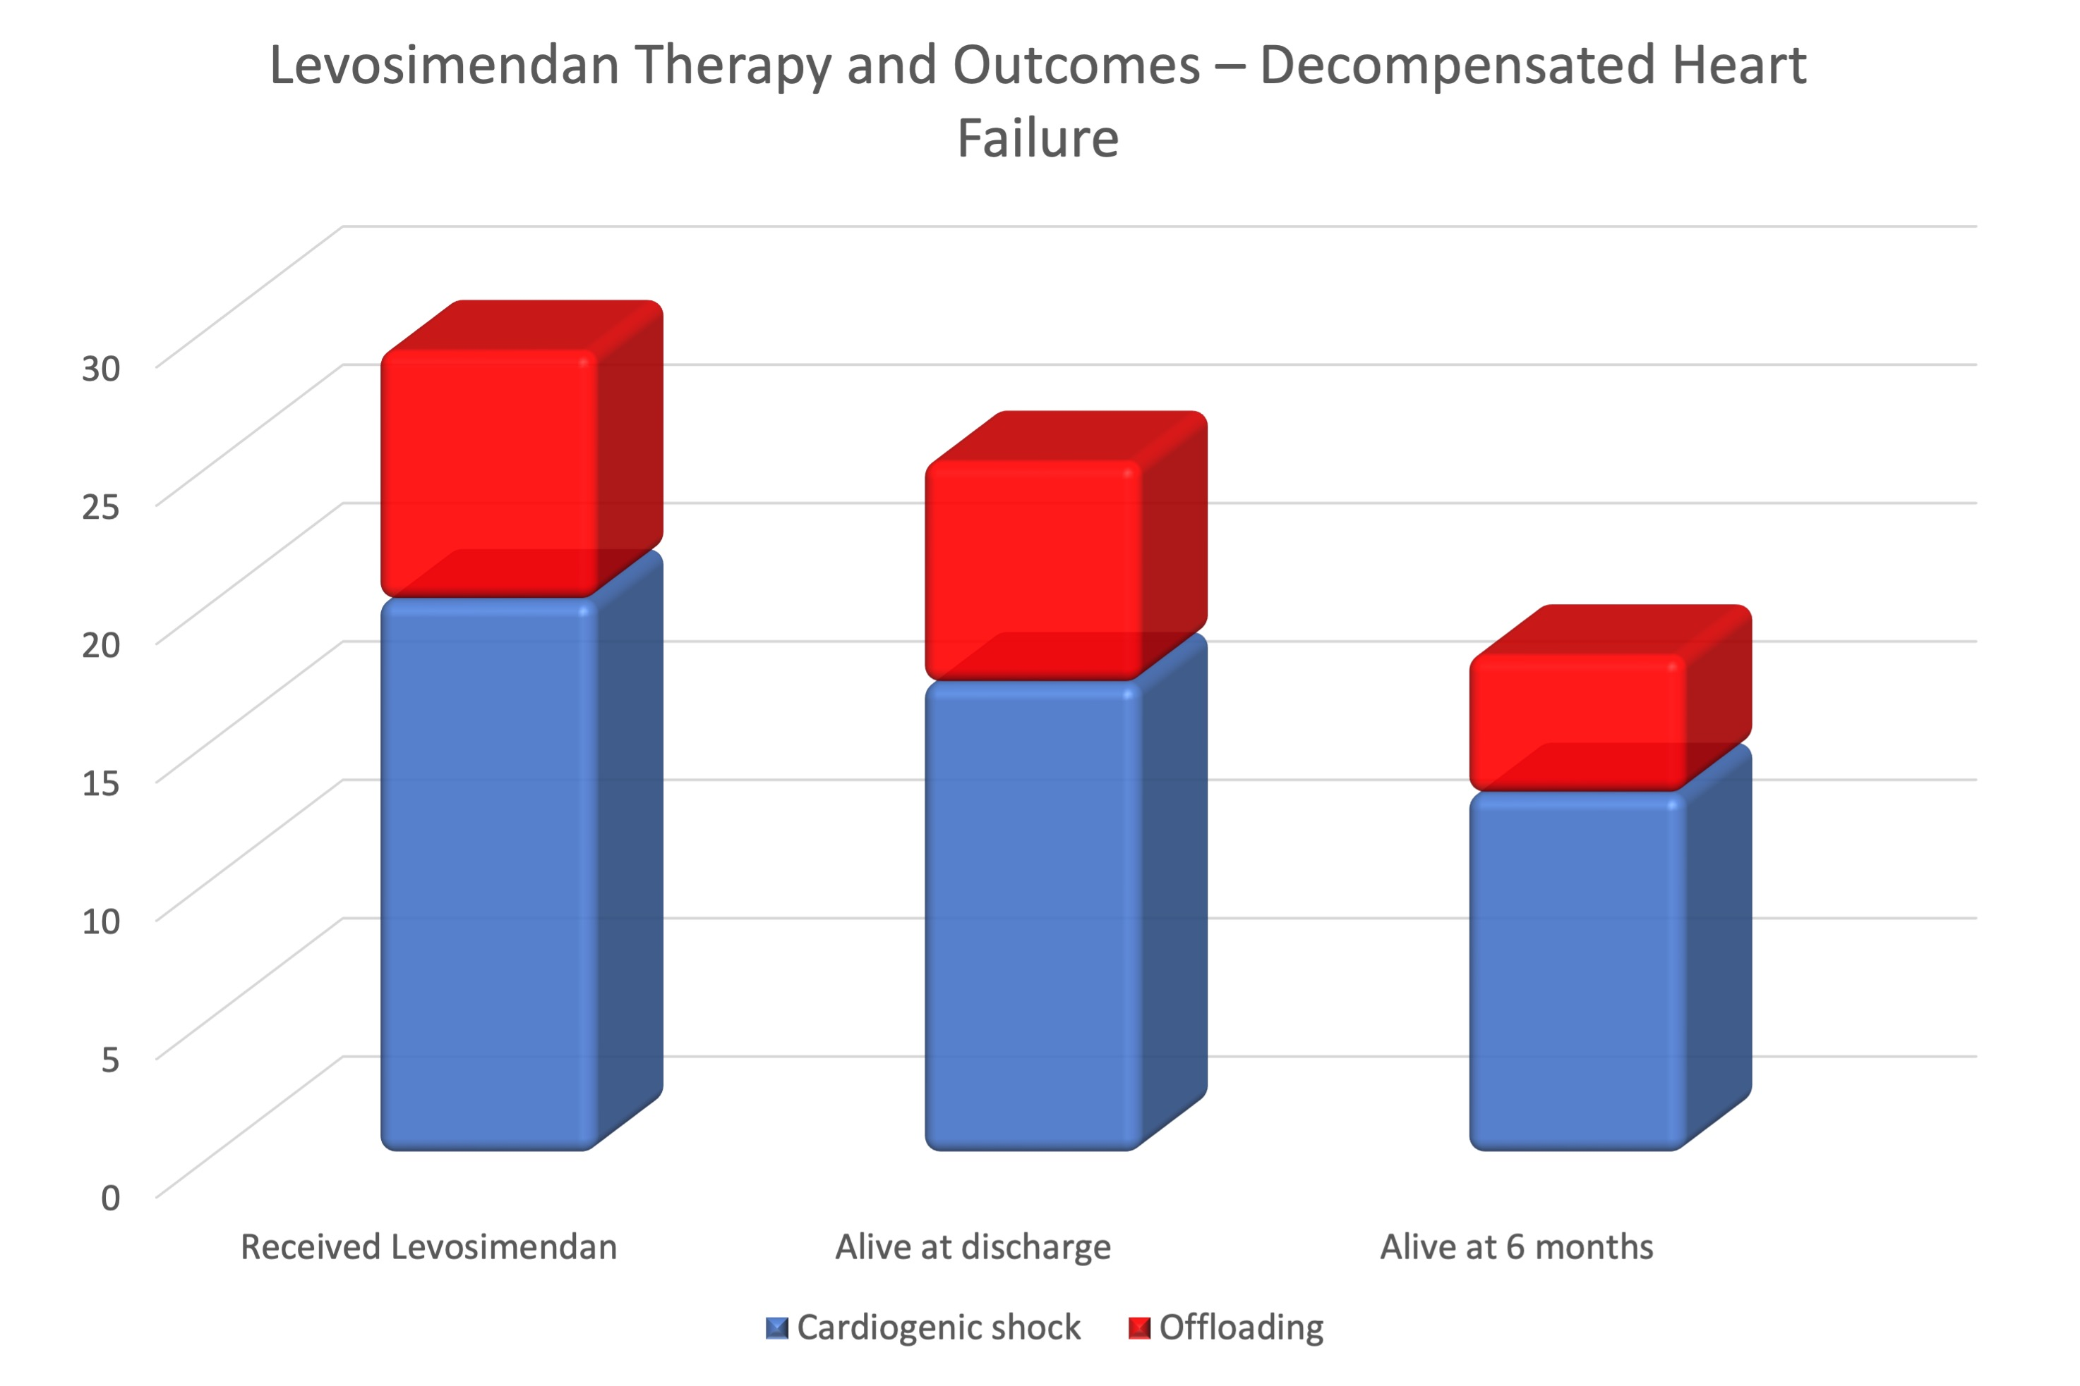
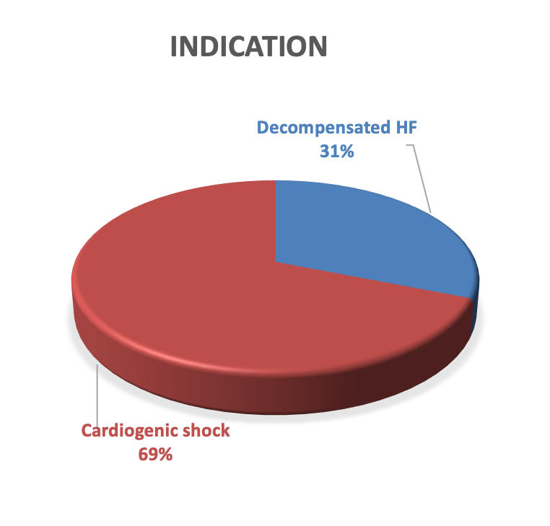
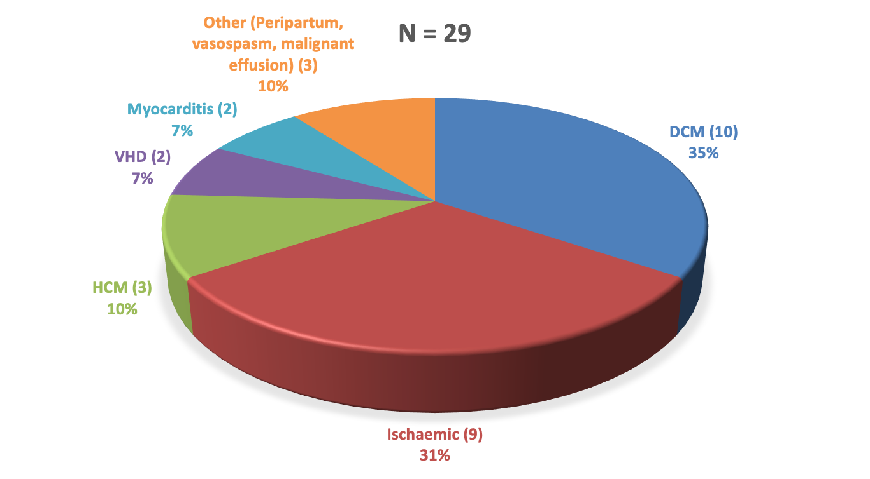
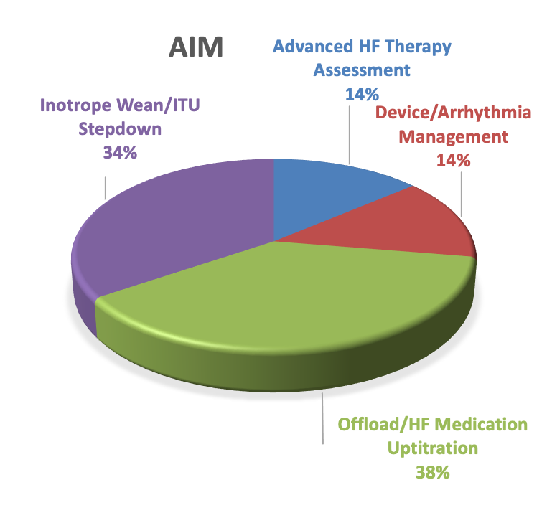
Patient-centred inotropic support - designing compassionate pathways for heart failure patients with decompensation
James Brown, Christopher Primus, Paul Wright, Martin Thomas.
Barts Heart Centre, St Bartholomew’s Hospital, Barts Health NHS Trust, London, UK
Background:
Admission to hospital with cardiogenic shock or refractory fluid overload as a complication of heart failure confers a poor prognosis.
One strategy is to provide temporary inotropic support, e.g. with the calcium sensitizer levosimendan, whilst targeted therapies (including diuretics, prognostic heart failure medications and cardiac resynchronization) demonstrate effect.
However, such inotropic agents require central venous access, invasive monitoring, and are rarely administered outside a Level 2/3 environment. These measures may be inappropriate heart failure patients.
MATERIALS & METHODS
Review of data:
The majority of heart failure patients (86%) treated with levosimendan did not have separate indications for ITU treatment. This allows stratification of patients, particularly as availability of ITU beds may be limited, resulting in treatment delays.
This would equate to 8-10 patients per year with an indication for levosimendan without ITU requirements.
CONCLUSIONS
Audit: All prescriptions for levosimendan across the 4 network hospitals between 2022 and 2024(36 months) were reviewed. The majority (77/86) were at the Barts Heart Centre. All case notes were reviewed and demographics, aetiology of heart failure and indication for therapy were recorded. The ward environment where levosimendan was administered, as well as length of stay and inpatient and 6 month mortality were also determined.
Review of data: potential patient groups that could benefit from ward-based levosimendan administration characterised.
Consultation: extensive discussion with major stakeholders including:
Nursing staff – Ward Sister and Matron
Lead Pharmacist
Critical Care Outreach Team and ICU Lead
Heart Failure Consultants
Design of Pathway
Pathway Design in final stages.
Cost-benefit analysis (ITU days saving and improved patient flow) in progress.
Patient survey planned.
Ward-based levosimendan with appropriate safeguards has the potential to improve patient comfort and streamline their care, whether that involves rapid treatment escalation, or allowing the opportunity for discharge to where the patient wishes to die.
OBJECTIVES
Consultation:
1. Current levosimendan prescribing policy was reviewed with our Lead Pharmacist, with adaptations for ensuring safety and appropriate monitoring for ward-based administration.
2. Design of suitable 2 bed high-visibility bay, agreement of clear start and stop criteria for levosimendan treatment, monitoring schedule and escalation pathway together with robust training programme and appropriate rota provision agreed with Ward Sister and Matron
3. Pathway ensures documented discussion with patient around treatment escalation decisions, with clear guidance for nursing staff that patient is not for escalation to ITU/CCOT and with DNACPR documentation in place prior to commencing treatment.
4. Rapid GDMT up-titration/CRT implantation if appropriate, or Social Care input and Palliative Care review. Pathway discussed at Audit Day and disseminated around all consultants and registrars covering the HF ward. Feedback being analysed.
Understand the demand for inotropic support with levosimendan in heart failure patients presenting with cardiogenic shock or refractory fluid overload across our network hospitals.
Ascertain barriers to administering inotropic support outside a Level 2/3 environment, to enable more timely treatment with streamlined medical +/- device therapy, or palliative care planning as appropriate, whilst minimizing disruption for the patient
Design a care pathway, in a high-visibility bay on a heart failure ward, defining treatment goals for the patient, with input from key stakeholders including nursing staff, pharmacists and critical care outreach.
RESULTS
Audit:
The majority (71/86) of levosimendan treatments were at Barts Heart Centre.
Of the 41 individual patients treated at BHC with levosimendan, 29 were heart failure patients (3 ACHD, 4 device-extraction, 5 post-operative).
Heart failure patients received levosimendan on ITU in 72% of cases, CCU in 28% of cases.
AETIOLOGY
REFERENCES
Levosimendan after cardiac surgery. RH Mehta et al. N Engl J Med 2017;376:2032-42.
Levosimendan for haemodynamic support after cardiac surgery. G Landoni et al. N Engl J Med 2017;376:2021-31.
Levosimendan Guideline for use RSCH Sussex Cardiac Centre.
Levosimendan in intensive care and emergency medicine: literature update and expert recommendations for optimal efficacy and safety Girardis et al. Journal of Anesthesia, Analgesia and Critical Care (2022) 2:4

