Slide 1


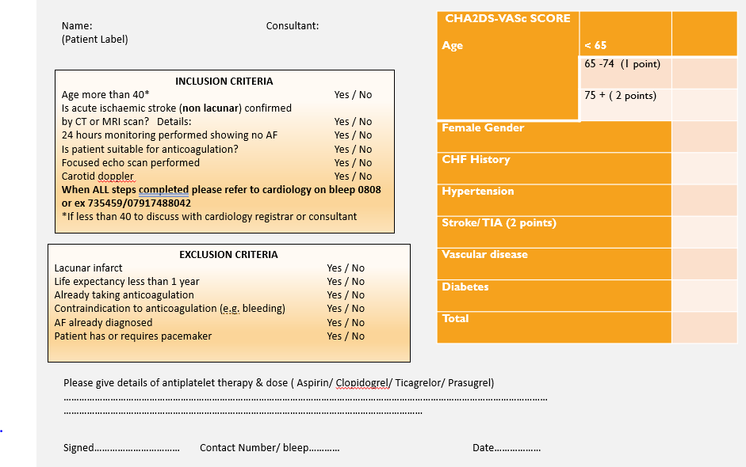
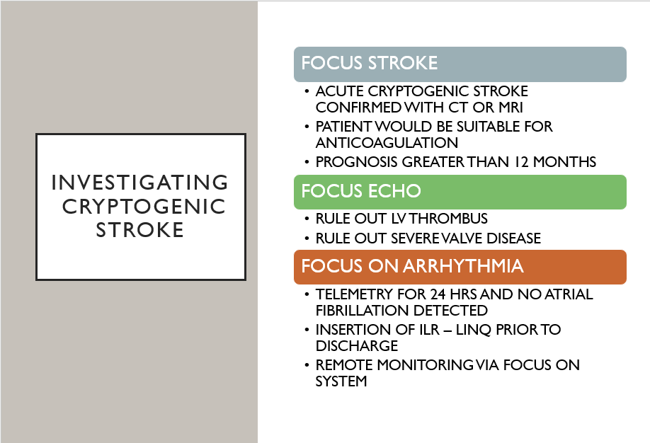

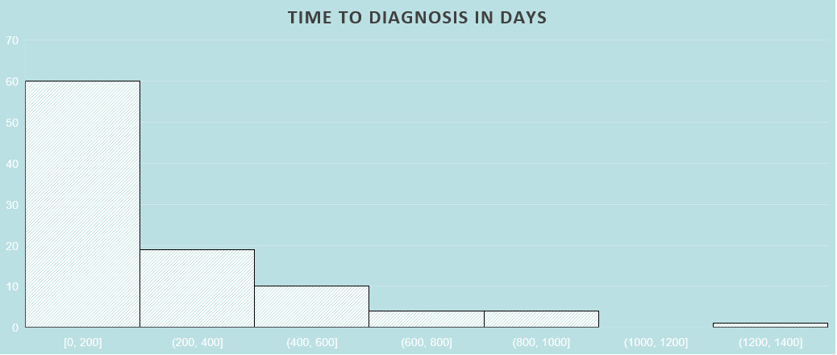
A retrospective analysis of effectiveness of creating an inpatient pathway for immediate insertion of implantable loop recorders in cryptogenic stroke patients.
Jacqueline Hunt ^{1,} Prof Nik Patel ^{2,} Rajdip Dulai ³, Rick A Veasey ⁴, Chemindra Biyanwila ⁵, Barbora Zemanova ⁵
¹Heart failure & devices specialist nurse ESHT, ²Senior Cardiology Consultant ESHT, ³ Cardiology Registrar ESHT, ⁴ Cardiology consultant ESHT, ⁵ Stroke consultant ESHT
Introduction
Methods
Conclusions
Cryptogenic stroke (CS) accounts for around 25-30% of all ischaemic strokes. Implantable loop recorders (ILRs) are NICE-approved devices for detecting atrial fibrillation (AF) in CS patients. Their implementation is variable with insertion typically occurring after discharge.
Through collaboration of Stroke and Cardiology teams we developed a multi-disciplinary (MD) pathway.
A retrospective analysis was conducted on CS patients receiving ILRs between May 2020- April 2025. Effectiveness was determined through analysis of detection of clinically significant arrhythmias and subsequent management changes.
AF detection significantly improved from 3-4% to 25%
The new pathway ensures appropriate and consistent investigation which results in around 13% of ischaemic stroke patients fulfilling criteria for ILR.
Nurse implantation demonstrates both time and cost efficiency.
Results
406 patients received an ILR following cardiac monitoring, carotid dopplers and focus echo.
359 (88%) were performed prior to discharge.
ILRs detected AF in 102 patients (25%), leading to anticoagulation in all but 3 patients, who had developed contraindications since implant.
Prior to implementing the pathway the detection rate of AF was 3-4%.
In 24 (23%) patients AF was detected within 30 days of monitoring. Median time to detection was 149 days, average 240 and range 1377 days.
49% (n=202) of implants were performed by a specialist nurse which equates to 50.5 hrs of cardiologist lab saving time, based on average procedure time of 15mins.
10 patients required permanent pacemaker (PPM) (significant pauses n= 3, AV block n=7) & 1 required Implantable Cardioverter Defibrillator (ICD) due to arrhythmias detected on ILR.
Future Considerations
Referrals could be unpredictable resulting in challenges in organising the procedure. Outpatient procedures were necessary to avoid discharge delays in some patients.
NHS tariff agreements result in single episode income therefore cardiology did not receive the full income associated with ILR insertion.
An additional rapid outpatient ILR pathway may yield increase cost efficiency for the cardiology department.
To create opportunity to capture patient experience
Reference: Sinha AM, Diener HC, Morillo CA, Sanna T, Bernstein RA, Di Lazzaro V, Passman R, Beckers F, Brachmann J. Cryptogenic Stroke and underlying Atrial Fibrillation (CRYSTAL AF): design and rationale. Am Heart J. 2010 Jul;160(1):36-41.e1. doi: 10.1016/j.ahj.2010.03.032. PMID: 20598970.
Objectives
To standardise care and improve the yield for AF detection post CS.
Order online at https://www.postersession.com/order/

